Slide 1
Lecture 2: Caffe: getting started Forward propagation
boris. ginzburg@intel.com

Slide 2
Agenda
Caffe – getting started
Test description
Network topology definition
Basic layers: definition and forward propagation
Convolutional
Pooling
ReLU
Fully Connected layer
Softmax
Implementation details of Convolutional layer
MNIST training

Slide 3
Open-source Deep Learning libraries
https://code.google.com/p/cuda-convnet2/ Just released. Excellent intro into CNN. Best Cuda.
http://torch.ch/ : Excellent tutorial, C++/Cuda, Lua.
http://caffe.berkeleyvision.org/ Very fast. C++/ CUDA, Python and Matlab wrappers
http://deeplearning.net/software/pylearn2/: Integrated with Theano, C++/Cuda, Python
http://torontodeeplearning.github.io/convnet/
C++/CUDA.

Slide 4


Slide 5
Caffe: installation
Ubuntu 12.04
Cuda 5.5 or 6.0 (SW - required, NVidia card is optional)
BLAS: OpenBLAS or Intel MKL(Math Kernel Lib)
$ git clone https://github.com/BVLC/caffe

Slide 6
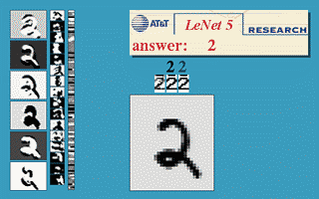
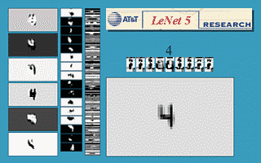
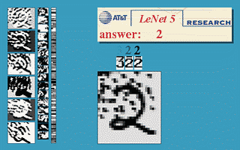
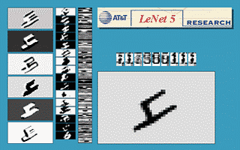
Caffe: example 1 - MNIST
Database: http://yann.lecun.com/exdb/mnist/
Demo: http://yann.lecun.com/exdb/lenet/index.html

Slide 7
Caffe: database format
src/tools/convert_mnist_data.cpp: MNIST format → leveldb
leveldb: https://code.google.com/p/leveldb/
Keys and values are arbitrary byte arrays
Data is stored sorted by key; callers can provide a custom comparison function to override the sort order.
The basic operations : Put(key,value), Get(key), Delete(key).
caffe “dev” branch supports lmdb: http://symas.com/mdb/
key-value , data is stored sorted by key
uses memory-mapped files: the read performance of a pure in-memory db while still offering the persistence of standard disk-based db
concurrent

Slide 8
Caffe: configuration files
Solver descriptor: http://caffe.berkeleyvision.org/mnist_solver_prototxt.html
Net descriptor:
http://caffe.berkeleyvision.org/mnist_prototxt.html
Parameters are defined in src/caffe/proto/caffe.proto.
Protobuf (Google protocol buffers) format - easy-to-use automatic generation of configuration files: https://developers.google.com/protocol-buffers/docs/overview

Slide 9
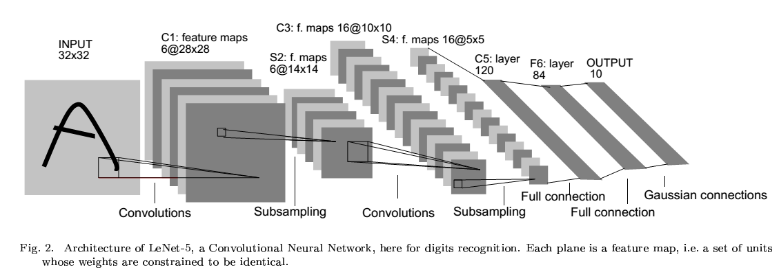
LeNet Topology
http://yann.lecun.com/exdb/publis/pdf/lecun-01a.pdf

Slide 10
LeNet topology
FORWARD
Soft Max
BACKWARD
Inner Product
ReLUP
Inner Product
Pooling [2x2, stride 2]
Convolutional layer [5x5]
Pooling [2x2, stride 2]
Convolutional layer [5x5]
Data Layer

Slide 11

Layer:: Forward( )
class Layer {
Setup (bottom, top); // initialize layer
Forward (bottom, top); //compute next layer
Backward( top, bottom); //compute gradient
}
Forward() propagate f to next layer:
$y_{l}=f\left(w_{l}, y_{l−1}\right)$

Slide 12
Data Layer
data
name: "mnist"
type: DATA
data_param {
source: "mnist-train-leveldb"
batch_size: 64
scale: 0.00390625
}
top: "data"
top: "label"
mnist-train-leveldb
label

Slide 13
Convolutional Layer
name: "conv1"
type: CONVOLUTION
blobs_lr: 1.
blobs_lr: 2.
convolution_param {
num_output: 20
kernelsize: 5
stride: 1
weight_filler {
type: "xavier"
}
bias_filler {
type: "constant"
}
}
bottom: "data"
top: "conv1”
conv1
conv1
Data
conv1
conv1

Slide 14
Convolutional Layer
for (n = 0; n < N; n++)
for (m = 0; m < M; m ++)
for(y = 0; y<Y; y++)
for(x = 0; x<X; x++)
for (p = 0; p< K; p++)
for (q = 0; q< K; q++)
y_{L} (n; x, y) += y_{L-1}(m, x+p, y+q) * w (m , n; p, q);
Add bias…

Slide 15
Pooling Layer
name: "pool1"
type: POOLING
pooling_param {
kernel_size: 2
stride: 2
pool: MAX
}
bottom: "conv1"
top: "pool1"
for (p = 0; p< k; p++)
for (q = 0; q< k; q++)
y_{L} (x, y) = max( y_{L}(x, y), y_{L-1}(x*s + p, y*s + q) );
Poolinh helps to extract features that are increasingly invariant to local transformations of the input image.

Slide 16
Inner product (Fully Connected) Layer
name: "ip1"
type: INNER_PRODUCT
blobs_lr: 1.
blobs_lr: 2.
inner_product_param {
num_output: 500
weight_filler {
type: "xavier"
}
bias_filler {
type: "constant"
}
}
bottom: "pool2"
top: "ip1"
Y_{L} (n) = ∑ W_{L}(n, m) * Y_{L-1} (m)

Slide 17
ReLU Layer
layers {
name: "relu1"
type: RELU
bottom: "ip1"
top: "ip1"
}
Y_{L} (n; x, y) = max( Y_{L-1}(n; x, y), 0 );

Slide 18
SoftMax + Loss Layer
X[0..9]
layers {
name: "loss"
type: SOFTMAX_LOSS
bottom: "ip2"
bottom: "label"
}
label
Combines softmax:
Y_{L} [i] = exp (Y_{L-1}[i] ) / ( ∑ (Y_{L-}[i] ); with log-loss :
E = - log (Y_{L-}(label (n) )

Slide 19
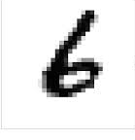
LeNet topology
Soft Max
10x1
Inner Product
10x1
ReLUP
500x1
Inner Product
500x1
Pooling [2x2, stride 2]
50x4x4
Convolutional layer [5x5]
50x8x8
Pooling [2x2, stride 2]
20x12x12
Convolutional layer [5x5]
20x24x24
Data Layer
1x28x28

Slide 20
Some Implementation details

Slide 21
Data Layer
All data is stored as BLOBs – Binary (Basic) Large Objects
class Blob {
Blob( int num, int channels, int height, int width);
const Dtype* cpu_data() const;
const Dtype* gpu_data() const; …
protected:
shared_ptr<SyncedMemory> data_; // containter for cpu_ / gpu_memory
shared_ptr<SyncedMemory> diff_; // gradient
int num_;
int channels_;
int height_;
int width_;
int count_;
}

Slide 22
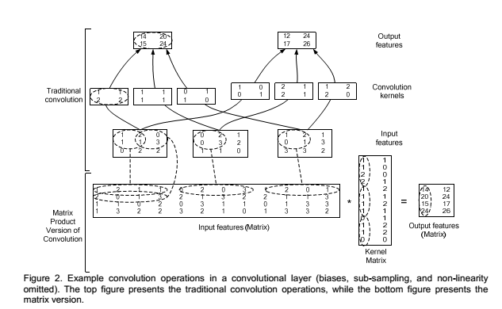
Convolutional Layer : im2col
Implementation is based on reduction of convolution layer to matrix – matrix multiply (See Chellapilla et all , “High Performance Convolutional Neural Networks for Document Processing” )

Slide 23
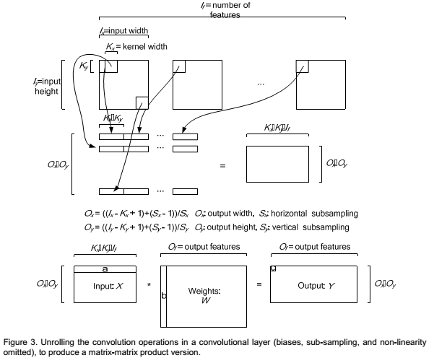
Convolutional Layer: im2col

Slide 24
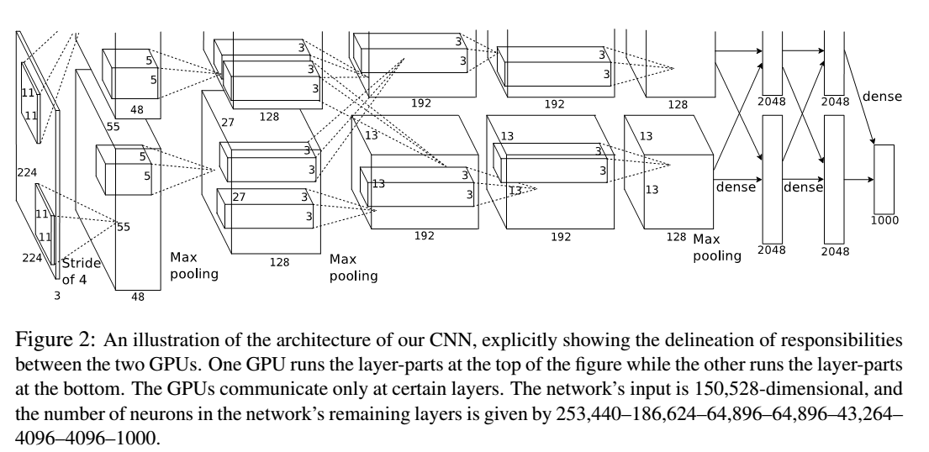
Convolutional Layer: groups
AlexNet topology (Imagenet)

Slide 25
Exercises
Play with Mnist topologies
How accuracy depends on topology?
Port one of following datasets http://deeplearning.net/datasets :
NORB, SVHN, …
Look at the definition of following layers:
sigmoid, tanh,

